Slide 1


What if every lesson could be a game?
AI and the development of interactive Mathematics Education.

Slide 2


🌐Online content
DBECloud
eLearning Platform
https://sasoldbeedustream.co.za/

Slide 3
🚨 The problem
🥱
Low learner engagement
👨🏻‍🏫
Passive slide-based learning.
🚧
Limited practice
⏱️
Teacher time constraints
💰
Development high cost

Slide 4





🎁 Why interactive content improve learning
Quick
race
Drag and
drop
Timed challenge
Instant feedback
Level progression
Retrieval practice
Active processing
Focused attention
Error correction
Motivation & persistence
Notes:
Retrieval practice is a powerful, research-backed learning strategy where you actively recall information from memory rather than passively re-reading texts or reviewing notes .
Active processing is a cognitive activity where the brain intentionally and effortfully manipulates incoming information to understand and remember it [1, 2]. Instead of passively absorbing data, the brain selects relevant material, organizes it into a coherent structure, and connects it to existing knowledge in long-term memory. [1, 2, 3]
The concept of active processing is broken down into three key stages:
Selecting: Consciously paying attention to specific information while ignoring distractions.
Organizing: Mentally structuring the selected pieces of information into a logical, integrated mental model (e.g., creating a mental timeline or summary).
Integrating: Connecting this new mental model to your prior experiences and existing knowledge.

Slide 5
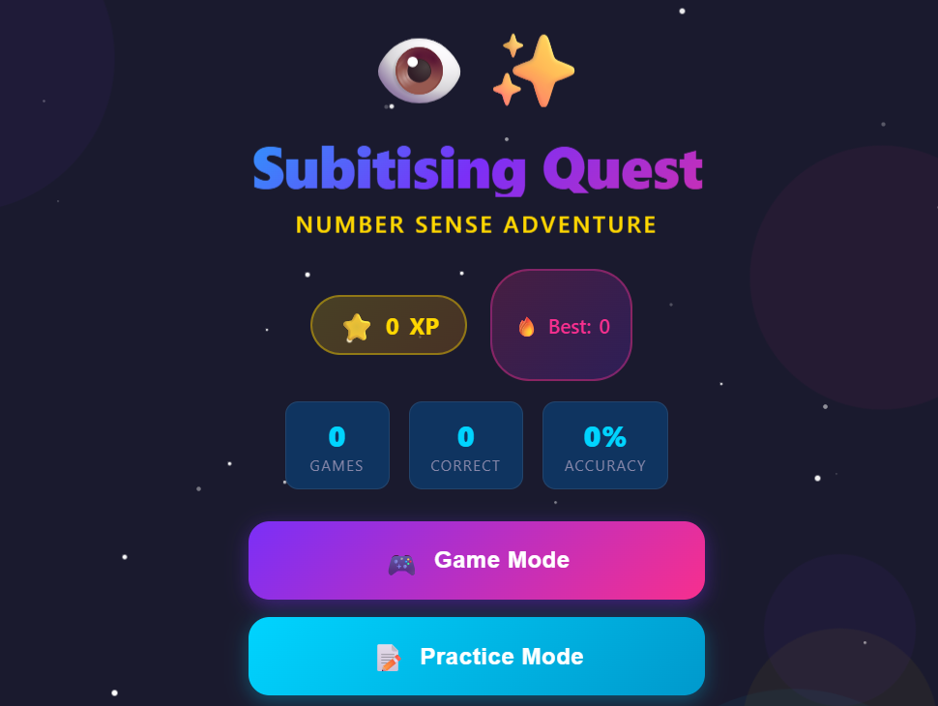
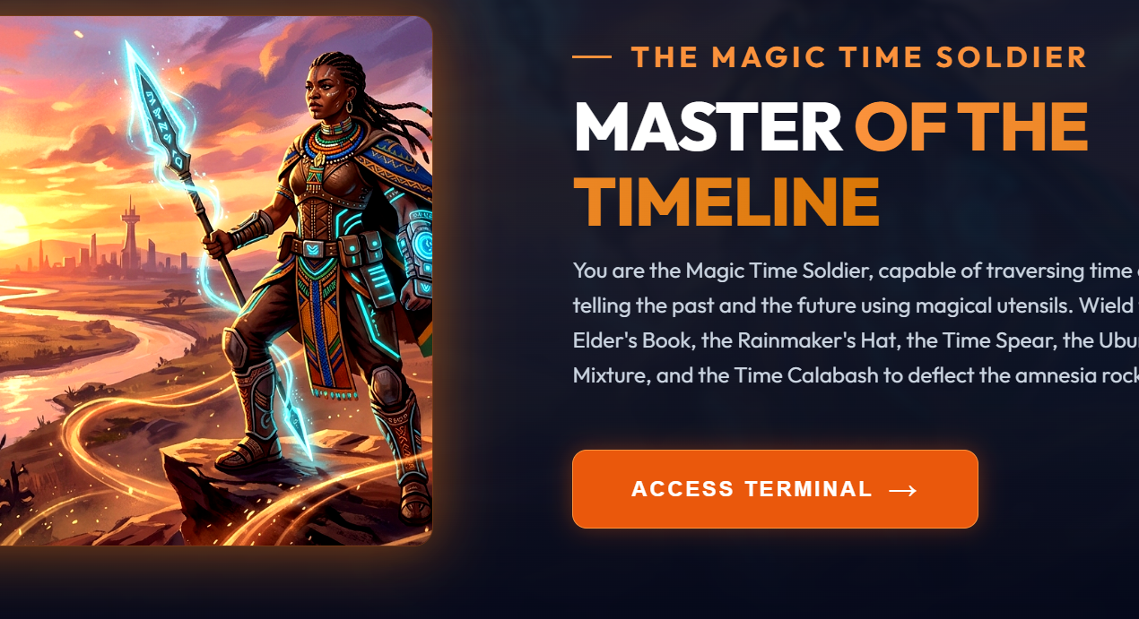
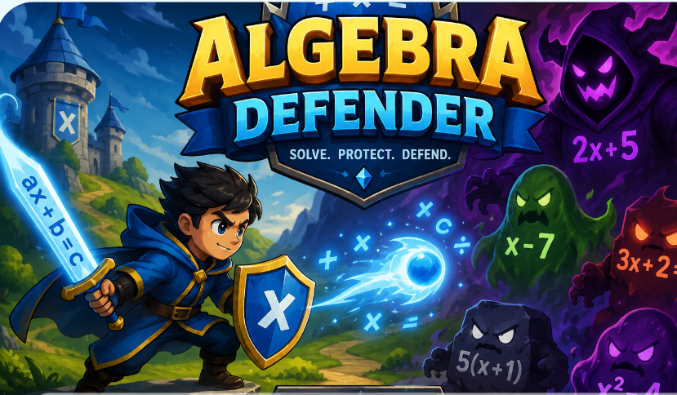
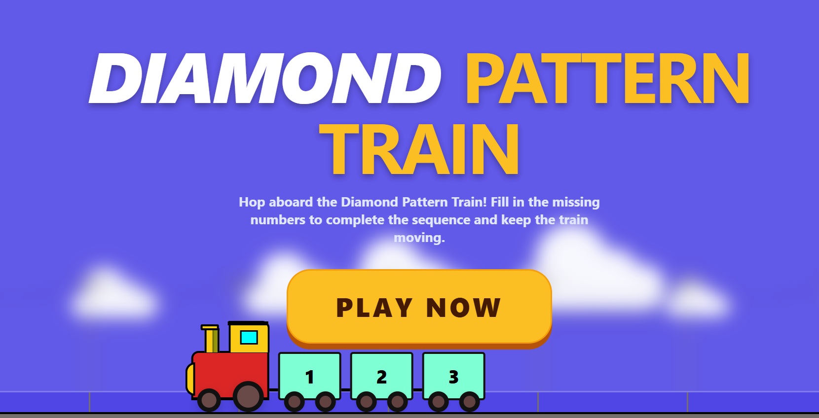
🏗️ What we have already built

Slide 6



Slide 7
🔁 The work-flow
💼
💡
🤖
✅️
From classroom experience
Teacher idea
AI builds draft
Teacher reviews
🚀
Publish/play offline

Slide 8
🏫From idea to classroom usage
🕓 Build time
15-30 min
From prompt to playable
🛡️Quality gate
Teacher
Human in the loop required
🗐 Reuse
Template
Clone and repeat
💻 Delivery
Offline
DBECloud

Slide 9






🔁Work-flow in action
Idea/prompt refinement
ChatGPT/Claude
Google AI Studio
Rapid prototyping, development and online deployment
Z.ai/DeepSeek/ QWEN
Development, temporal deployment and download

Slide 10

🔁Work-flow in action
Prompt
Test
GPT 5.6 Sol
Refine
Clickup
Deploy/Share
Opus 4.8
Play
Notes:
ClickUp is a cloud-based work and project management platform designed to replace multiple productivity apps. It allows teams and individuals to centralize their tasks, documents, whiteboards, chat, goals, and time tracking into a single, highly customizable workspace.

Slide 11
💬The prompts
1. 🎯 Define the AI's Role
Tell the AI who it should be.
Examples:
Expert Mathematics Teacher
Instructional Designer
Educational Game Designer
UX Designer
JavaScript Developer
Accessibility Specialist
Example:
You are an expert Mathematics teacher, instructional designer and educational game designer…

Slide 12
2. 👩‍🏫 Define the Learner
AI performs much better when it knows exactly who the activity is for.
Include:
Grade
Age
Subject
Curriculum
Prior knowledge
Example:
Design an activity for Grade 8 Mathematics learners following the South African CAPS curriculum for [topic]..

Slide 13
3. 🎓 Learning Goal
What should learners be able to do?
Example:
Learners should be able to determine the solution of a linear equation…

Slide 14
4. 🎮 Activity Type
Specify exactly what you want.
Examples
Quiz Challenge
Simulation
Drag and Drop
Puzzle
Board Game
Platform Adventure
Example:
Create a drag-and-drop activity.

Slide 15
5. 📚 Educational Content
Specify exactly what must appear.
Example
Include
15 questions
Increasing difficulty
Real-life examples
Worked examples
Random values
Example:
Generate 30 random question in 3 increasing difficulty levels. Add worked examples for every level.

Slide 16
6. ✨ User Experience (UX)
Specify how learners should experience the activity.
Examples
Colourful interface
Modern design
Smooth animations
Large buttons
Mobile friendly
Touch friendly
Example:
The user interface should be vibrant, using smooth animations, mobile and touch friendly…

Slide 17


💬The prompts
7. 🏆 Game Mechanics
This transforms an exercise into a game.
Examples
Score
Timer
Levels
Coins
Stars
Badges
Leaderboard
Lives
Unlock achievements
Confetti
Sounds
Notes:
Motivation is defined as the urge to make progress toward a goal. Game mechanics can be used to motivate us intrinsically (without a promise of an external reward) or extrinsically (with a promise of an external reward).

Slide 18
8. 💬 Feedback and Scaffolding
Excellent educational apps always teach.
Tell AI to include
Immediate feedback
Explanations
Hints
Retry opportunities
Encouragement
Final summary
Example:
The app should provide immediate feedback for correct and incorrect answer, hints, retry opportunities…

Slide 19
9. 💻 Technical Requirements
This is probably the most important section.
Example:
Generate ONE standalone HTML file. Include all HTML, CSS and JavaScript. No external files. No React. No NodeJS. No Vue. Use Vanilla JavaScript. Responsive. Works offline. Do not use placeholder images. Output only the HTML.

Slide 20
10. 🔄 Refinement Instructions
Very few first drafts are perfect. Ask AI for improvements.
Example:
Add animations. Simplify for Grade 5. Make the buttons larger.
Add a teacher mode. Increase accessibility. Add sound effects. Make the questions random. Improve the colour palette.

Slide 21

The "Golden Rule"
The quality of the app is determined by the quality of the prompt.
Then reinforce the core idea:
🎯 Be specific.
📝 Provide educational context.
🎮 Describe the desired interaction.
💡 Include game mechanics.
💻 State technical requirements.
🔄 Refine the AI's first response.

Slide 22
🛡️Governance, privacy, and quality assurance
Teacher approval required: nothing is published automatically.
Curriculum alignment: prompts use CAPS outcomes.
Local deployment option: games can run on Moodle/DBECloud.
Learner data minimization: collect only what is needed for progress tracking.
Accessibility: keyboard navigation, readable fonts, multilingual support.

Slide 23
Lara.h@dbe.gov.za

Slide 24


